Slide 1
DSP LAB EXPERIMENT -04
Priya
17EE01044

Slide 2
AIM-
1.To compute pulse rate of given ppg signal using DFT method a) find the magnitude spectrum of DFT signal b) Compute period of a signal and compare with autocorrelation based period

Slide 3
THEORY
DFT
discrete-time data sets are converted into a discrete-frequency representation
This is in contrast to the DTFT that uses discrete time, but converts to continuous frequency
Since the resulting frequency information is discrete in nature, it is very common for computers to use DFT(Discrete fourier Transform) calculations when frequency information is needed

Slide 4
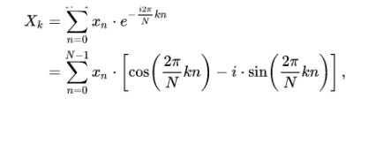
DFT calculated as
Where L is length of x[n] and N is length of X[k] and N>=L for reconstructing signal
K=0,1,.....N-1

Slide 5
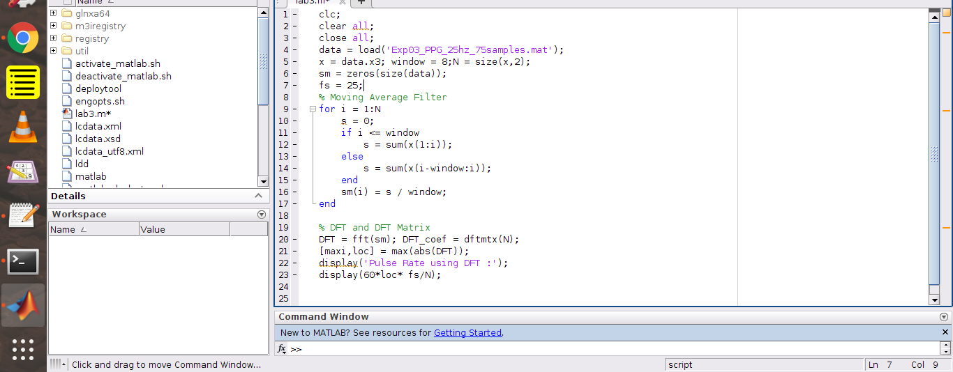


Slide 6
conclusion
Autocorrelation function is more accurate than DFT because it extract similarity from signal hence much more near to real signal.

